Slide 1



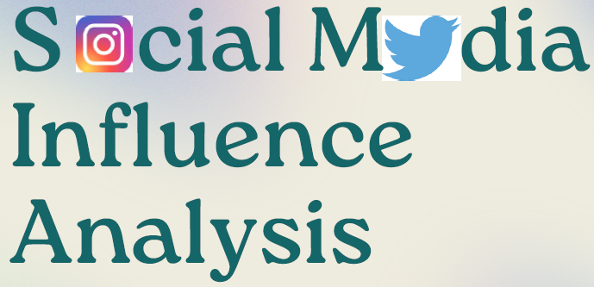
Integrated Program in Business Analytics
Group B – IPBA 13
Kartik Kohli | Srishti Sharma
Himanshu Sharma | Sai Anirudh Karimuri
Sukant Srivastava | Nidhi Mathur
Praveen Vyas | Parag Raut

Slide 2
Agenda
Project Objective
Executive Summary
Data Overview and Key Business Assumptions (if any)
Data Preparation and Pre-processing
Sanity checks, treatment and transformations for analytical dataset preparation
Exploratory Data Analysis
Key Business Findings and Insights
Model Development and Validations
Model comparisons on key scoring metrics and model finalization
Dashboarding (required only when it is in scope of analysis)
Businesss Recommendations and Potential Business Impact
Next Steps
Appendix

Slide 3


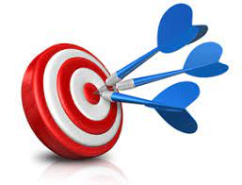
Project Objective
 | Social media sentiment analysis is the process of collecting and analyzing information on how people talk about a particular brand on social media.
 | Rather than a simple count of mentions or comments, sentiment analysis considers emotions and opinions.
 | Primary Objective is to Integrate an NLP model in ML to ascertain the sentiment of a comment towards a marketing strategy of a particular brand.

Slide 4
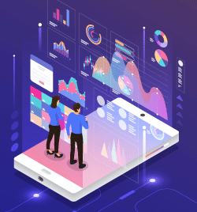


Social Media Sentiment Analysis Process Flow
Data Collection
Data Analysis
Data Visualization
Data Processing
Using Web Scrappers
Using API
Using a Web browser plugin
Using open source repositories
Tokenization
Lower case conversion
Stop Words removal
Lemmatization
POS Tagging
Develop a Model
Train the Model
Test the Model
Deploy the Model

Slide 5
About Sentiment Analysis

Slide 6


Data Overview and Key Business Assumptions
Brand Name | About the Ad Campaign | Link/Source of Ad
 | In November2022, Balenciaga dropped its holiday ad campaign featuring children holding teddy bears in bondage harnesses and costumes. (The BDSM accessories were also on the runway at Balenciaga’s show at Paris Fashion Week.)
 | In January 2019, Gillette, a men's grooming brand owned by P&G, released an advertisement titled "We Believe: The Best Men Can Be." The ad addressed issues such as toxic masculinity, bullying, sexual harassment, and sexism, and called on men to be better versions of themselves.

Slide 7
Data Preparation and Pre-processing

Slide 8
Exploratory Data Analysis

Slide 9
Model Development and Validations

Slide 10
Dashboard

Slide 11
Business Recommendations and Potential Business Impact

Slide 12
Sentiment Analysis
Integrating an NLP model in ML to ascertain the sentiment of a comment towards a marketing strategy of a particular brand

Slide 13
Thank You

